Slide 1

Computer Vision
Introduction

Slide 2


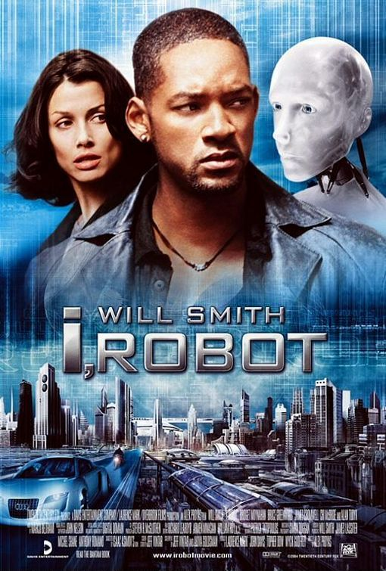


Slide 3
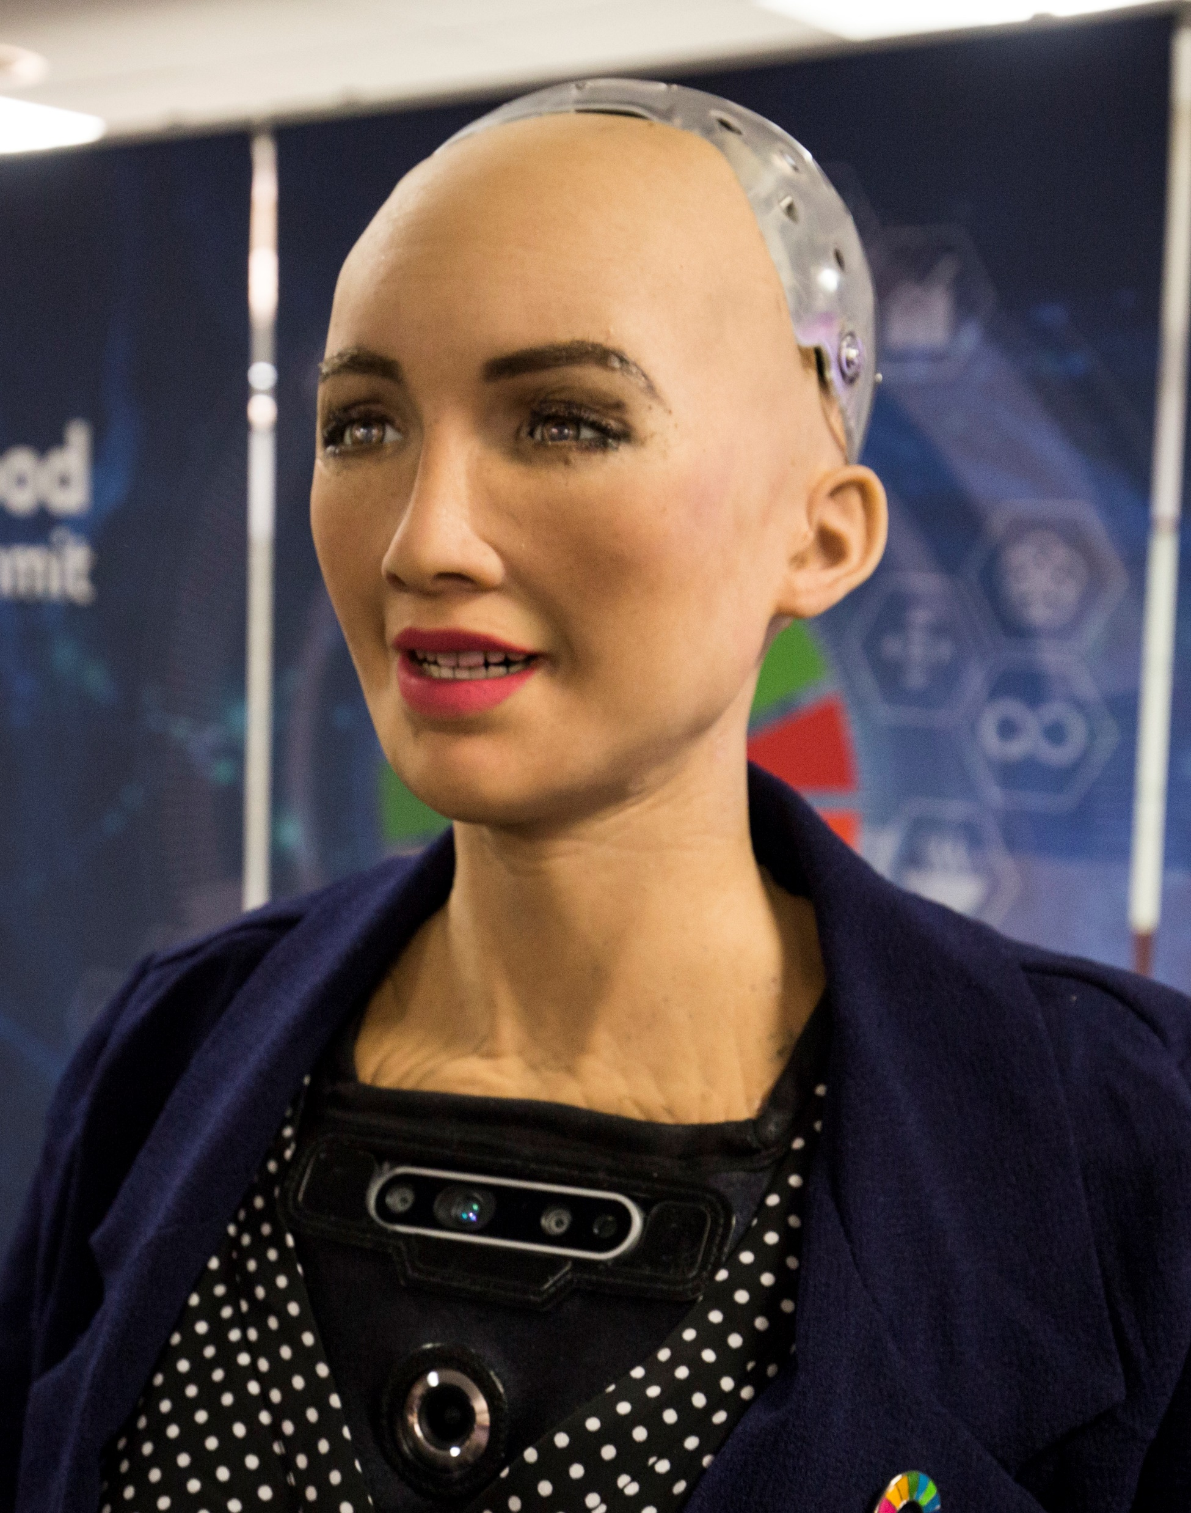

Slide 4
So why bother learning computer vision?

Slide 5
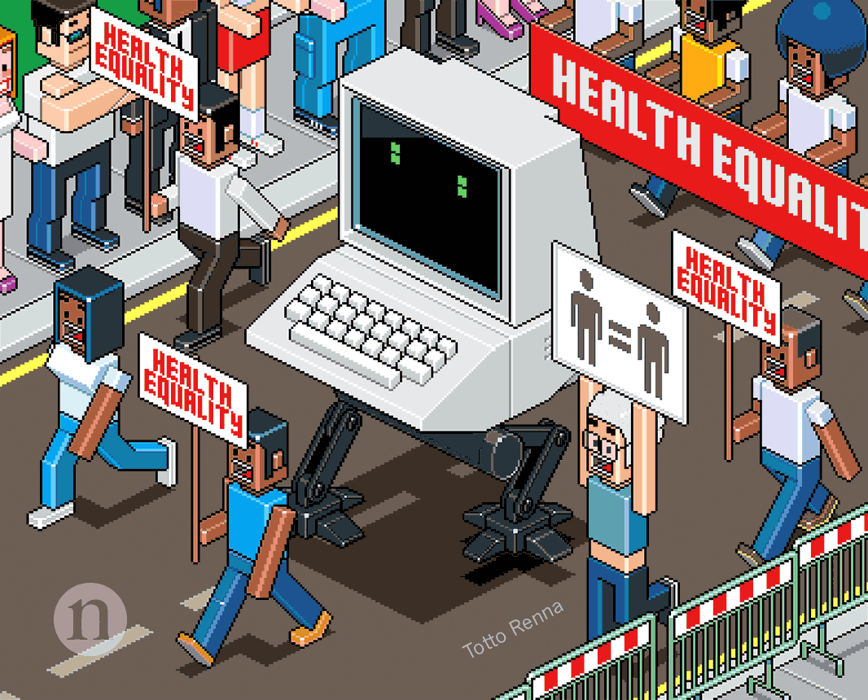
The medical field

Slide 6
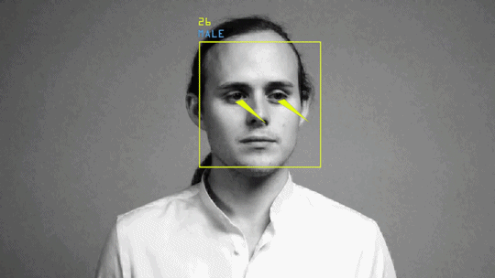
The world is full of images and videos :
your phone, Youtube, Auto tag in Facebook (Face Recognition)

Slide 7
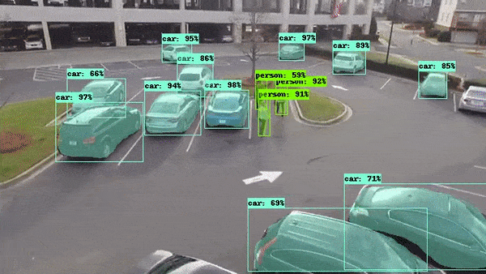
Object Detection

Slide 8
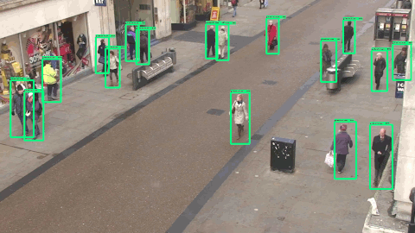
Surveillance

Slide 9
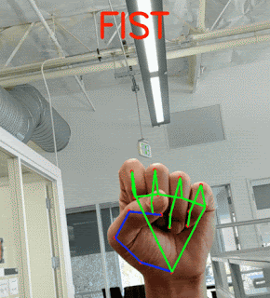
hand gesture recognition (for sign language)

Slide 10
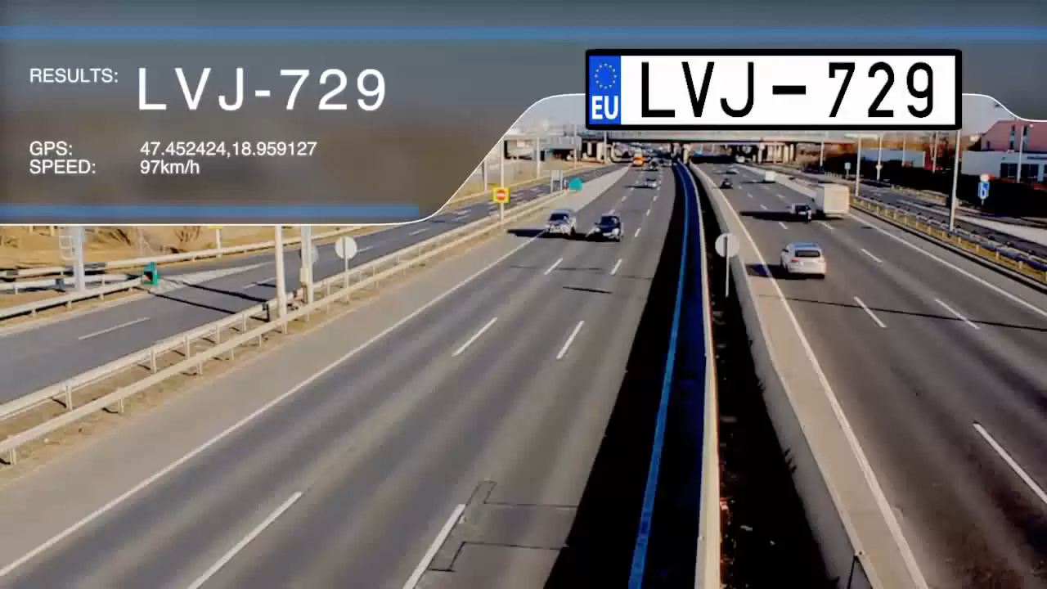
License Plates Recognition

Slide 11
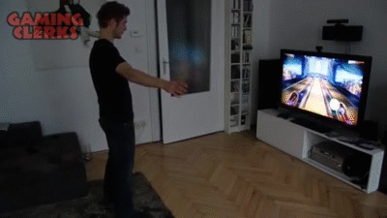
Gaming Xbox Kinect

Slide 12
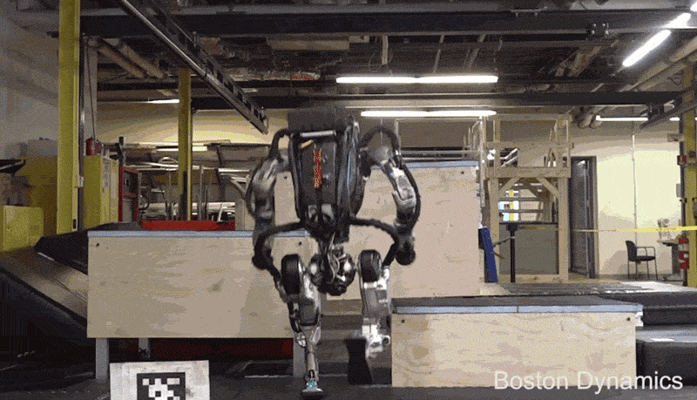
Robotics and Military

Slide 13


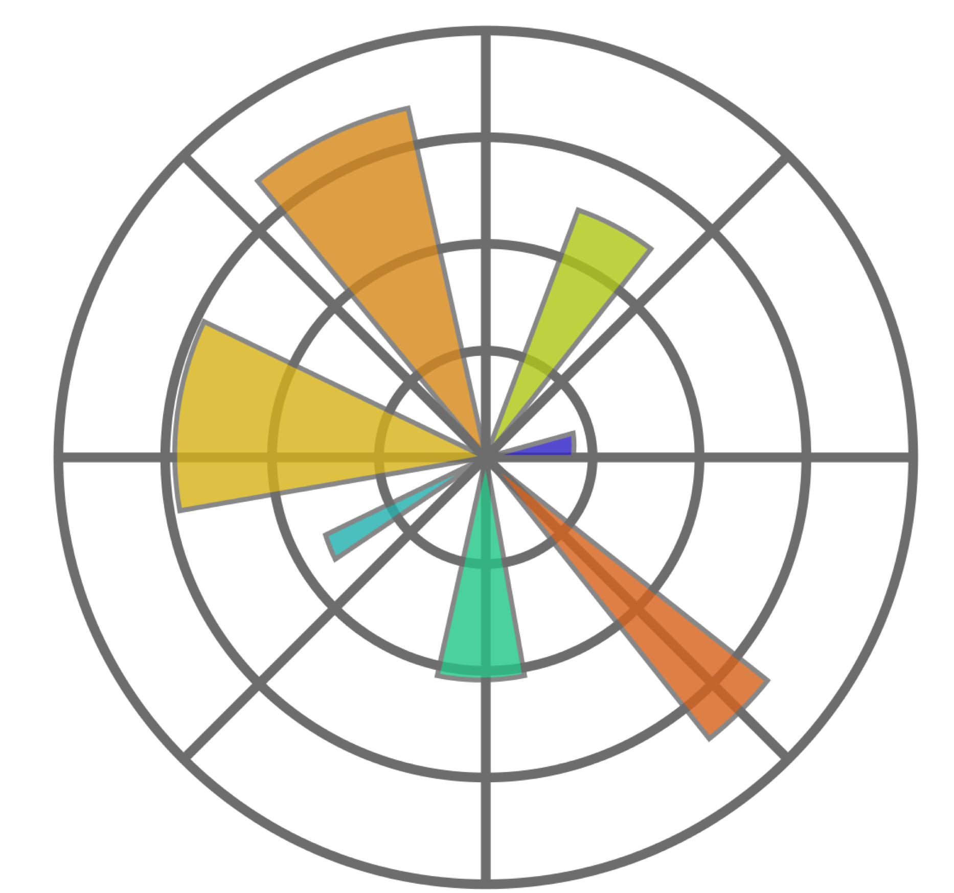
Prerequisites
Python
Numpy
Matplotlib

Slide 14
1-You don’t know python?
2-Course is on Github

Slide 15

See You in the Next Video

